Slide 1



Supervised Fine-Tuning for Unsupervised KPI Anomaly Detection
for Mobile Web Systems
WWW 2024
2024 / 06 / 26

Slide 2

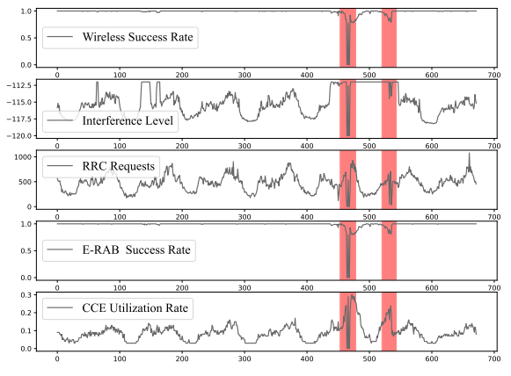
01
Background
Wireless Base Station (WBS)
Anomaly Detection
Different
Feedback date:
False positives(false alarms)
*False negatives(missed alarms)
知行合一、经世致用
自强不息 厚德载物
Tsinghua University of China
Central South University
Notes:
用户体验下降，服务中断

Slide 3
02
Question
Current MTS anomaly detection methods struggle to utilize feedback, especially the feedback of false negatives.
Chanllenge:
Scarce data. Anomalies in WBS are infrequent, and due to operators’ preference for anomaly detection methods’ configurations, false negative feedback data are even rarer. It is difficult for semisupervised MTS anomaly detection methods to learn effectively from the scarce data of false negative feedback, which operators are seriously concerned.
Biased data distribution. The distribution of the feedback data collected after deploying an MTS anomaly detection method can differ significantly from that of the training data because of software/hardware upgrades and configuration changes. This discrepancy may cause model contamination during the feedback-based performance improvement
知行合一、经世致用
自强不息 厚德载物
Tsinghua University of China
Central South University
Notes:
模型污染

Slide 4
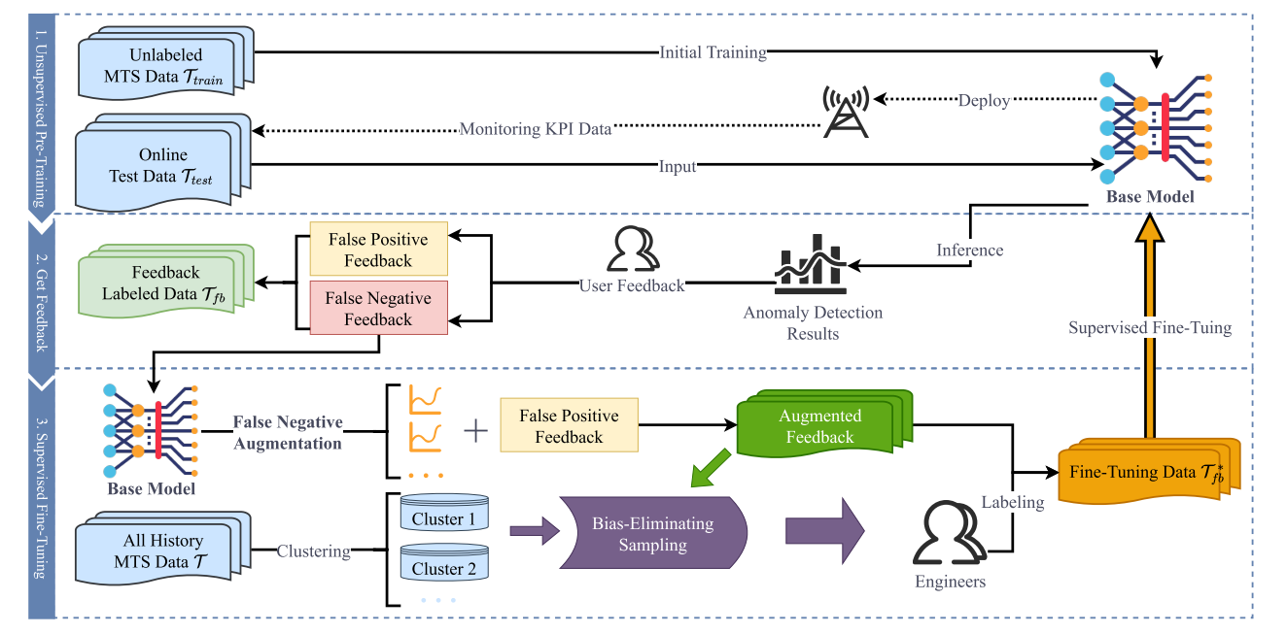
03
Method
Fine-tuned
Scarce data
Biased data distribution
Label-Aware Evidence Lower BOund (LAELBO) loss funtion
False negative augmentation mechanism
Two-Stage Active Learning (TSAL) mechanism
知行合一、经世致用
自强不息 厚德载物
Tsinghua University of China
Central South University

Slide 5
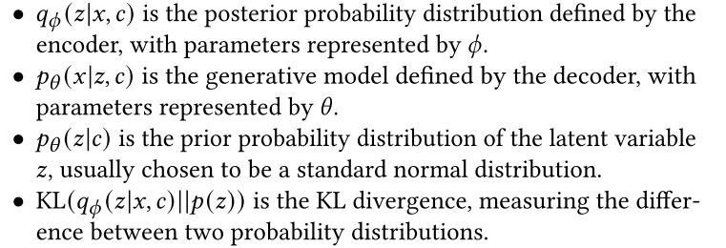
03
Method-LAELBO
Vanilla ELBO:
Label-Aware Evidence Lower BOund (LAELBO):
y : labels
𝑦 = 0 minimize the reconstruction error and KL divergence
𝑦 = 1 amplify the reconstruction error and KL divergence
知行合一、经世致用
自强不息 厚德载物
Tsinghua University of China
Central South University

Slide 6
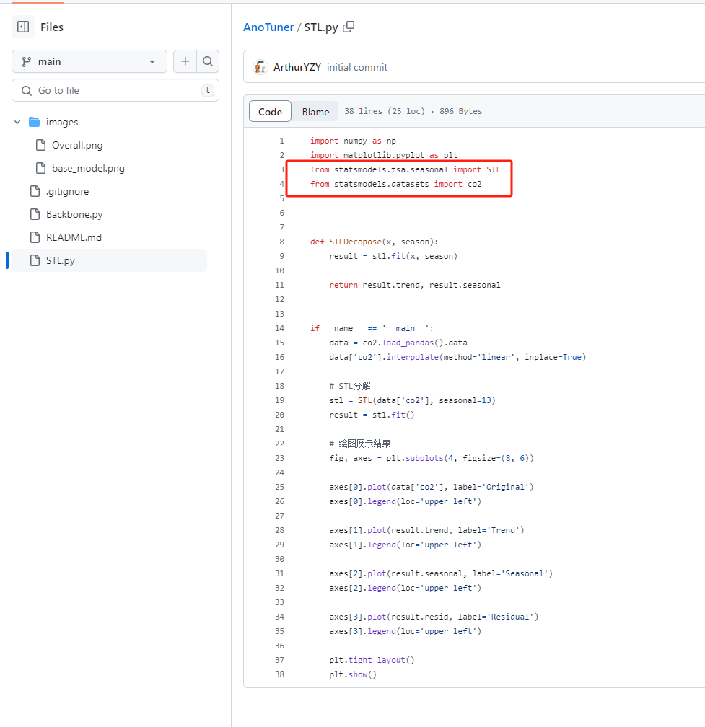
03
Method-FNA
Not really open source
Description not clear enough
Model introduction incomplete
知行合一、经世致用
自强不息 厚德载物
Tsinghua University of China
Central South University

Slide 7
03
Method-FNA
Original:
It is also worth noting that the primary cause of false negatives is the incorporation of anomalous data or noise into the training data. The model incorrectly learns the pattern of the anomalies during the unsupervised training stage, resulting in the reconstructed data being indistinguishable from the original data. This fact precisely illustrates that AnoTuner can effectively generate data similar to the false negative data without worrying about a significant difference between the generated and real data.
Overfitting to abnormal patterns
Missed alarms
Overfitting to
abnormal patterns
Reconstructing abnormal data distribution
知行合一、经世致用
自强不息 厚德载物
Tsinghua University of China
Central South University

Slide 8
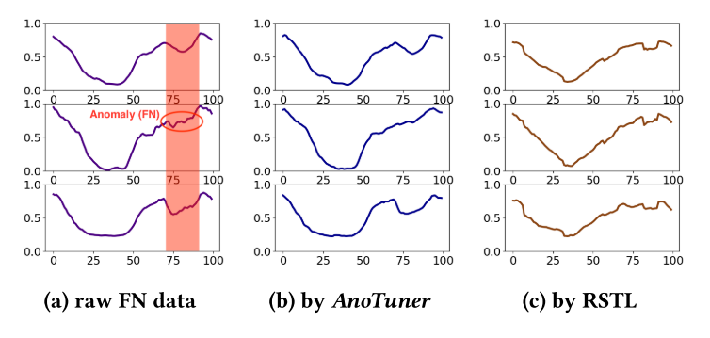
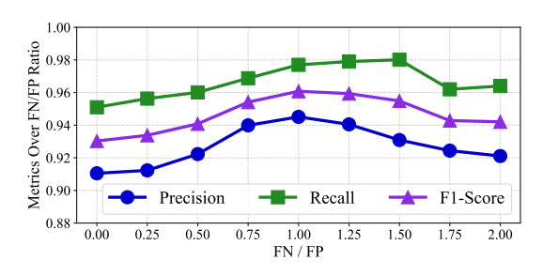
03
Method-FNA
which results in the mean, 𝜇, and standard deviation, 𝜎of the distribution.
Subsequently, we generate a set of latent variables, denoted as {z₁, z₂ ..., z_{n} }, by performing multiple samplings from a standard Gaussian distribution N(0, 1).
The original false negative feedback data is then decomposed by Seasonal-Trend Decomposition (STL) These components are combined to derive a conditional variable c.
In the final step, each latent variable z_{i} is concatenated with the conditional variable and dispatched to the AnoTuner decoder for decoding, thereby producing the generated data.
知行合一、经世致用
自强不息 厚德载物
Tsinghua University of China
Central South University

Slide 9
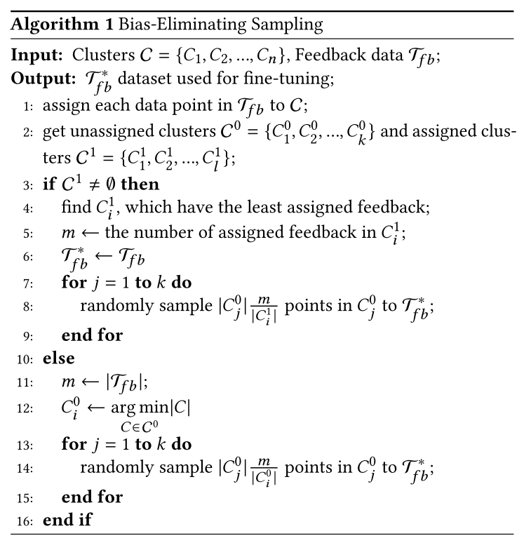
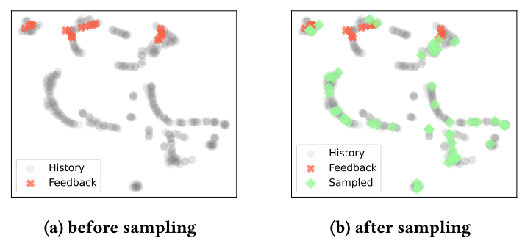
03
Method-TSAL
Cluster-based filter : OmniCluster
Bias-eliminating sampling:
Ensure that the dataset used for fine-tuning reflects the true distribution of the original dataset, thereby reducing bias in model training
知行合一、经世致用
自强不息 厚德载物
Tsinghua University of China
Central South University
Notes:
基于集群的过滤器：OmniCluster
消除偏差采样：

Slide 10
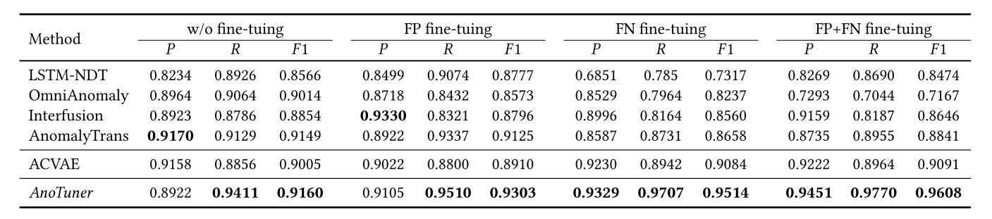
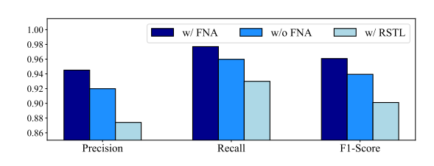
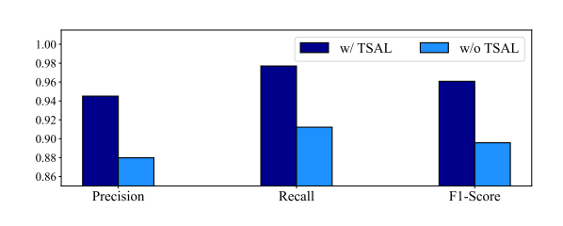
04
Result
知行合一、经世致用
自强不息 厚德载物
Tsinghua University of China
Central South University

Slide 11
05
Conclusion & Reward
Discovering problems from data characteristics
Fine-tuning can be considered for anomaly detection to learn indistinguishable faults
知行合一、经世致用
自强不息 厚德载物
Tsinghua University of China
Central South University
Notes:
通过以上内容，我们得出结论，转换器对时间序列的时间建模能力被夸大了，至少对于现有的LTSF基准来说是这样。
根据我们的发现，我们还主张重新审视基于变压器的解决方案在未来其他时间序列分析任务（如异常检测）中的有效性。

Slide 12


谢 谢 大 家
THANKS FOR ALL

